Slide 1
THE NEXT GENERATION INITIATIVE
ADOPTED BY THE 241ST ASSEMBLY OF THE SYNOD OF THE MID-ATLANTIC, RICHMOND VA

Slide 2
The 240th Synod Assembly, September 11-12, 2017, a draft document for a new initiative was shared with the assembly titled “The Next Generation.” This initiative seeks to respond to the critical shortage of African American Clergy in the Presbyterian Church (USA) and the need within every presbytery to be served by able Black leadership. In response to this challenge, the Synod of the Mid-Atlantic would commit itself to identifying, nurturing and serving as advocates for the next generation of African American clergy to serve congregations, councils of the church and throughout the Presbyterian structure and beyond.

Slide 3
BLACK GOVERNING BODIES INDICATES THAT AT ONE POINT
BLACK CHURCH GROWTH IN SOME AREAS EXCEEDED WHITE CHURCH GROWTH
16-BLACK PRESBYTERIES
4-BLACK SYNODS
Around 1880, Catawba Presbytery (Black Presbytery) organized more Black Churches in the Charlotte NC Area than Mecklenburg Presbytery (White Presbytery)

Slide 4
A SIGNIFICANT SHIFT IN LEADERSHIP FOR BLACK PRESBYTERIAN OCCURRED!
CHURCHES, PRESBYTERIES AND SYNODS IN THE SOUTH MAY HAVE EXPERIENCED THIS THIS SHIFT MORE THAN OTHERS, YET THE ENTIRE CHURCH HAS SUFFERED

Slide 5
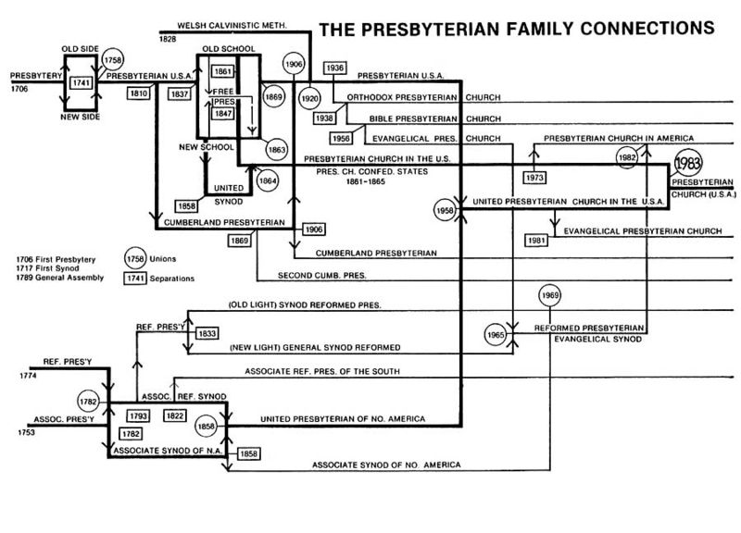

Slide 6
Time Period 1983
In 1983, the United Presbyterian Church in the U.S.A. and the Presbyterian Church in the United States merged to form the Presbyterian Church (U.S.A.). The Presbyterian Church in the United States was located in the Southern and border states while the United Presbyterian Church in the United States of America was located in every state. These two denominations were the largest Presbyterian bodies in the United States at the time.
The merger was a reunion of two churches that were once united prior to the Civil War. Like the Baptists and the Methodists, the Presbyterians broke off into northern and southern religious bodies in 1861 despite having similar doctrine and church polity. Although it took more than a century for these Presbyterian bodies to reunite, the merger subsequently created the largest Presbyterian denomination in the country.

Slide 7
REUNION 1983 UPCUSA and PCUS
Each Synod Adopted Articles of Agreement
.
Three synods created the Synod of the Mid-Atlantic.
Mid-Atlantic was the last of 16 synods to be organized.
Four All Black Presbyteries & one Inter-presbytery agency must be dissolved
Synod of the Piedmont
Synod of North Carolina
Synod the of Virginias

Slide 8
ISSUES IMPACTING REUNION
Catawba presbytery
Cape Fear presbytery
Southern Virginia presbytery
Yadkin presbytery
The Catawba Inter-presbytery Agency
Program funding curtailment
Loss of Identity
Loss of Black History
Loss of Black participation on governing boards
Loss of power
Loss of community
Depersonalization
Operating un Robert’s
Change in lifestyle
Disengagement
Dissolving
????????????????????????????

Slide 9
REUNION DISRUPTED The Leadership Pipeline This was Possibly an Unintentional Consequence of Reunion

Slide 10
A Way to Reverse the Trend
Katie Cannon Called the First Order of the Day around the Installation of Dr. Brian Blount
BPU in National Capital Presbytery Called an Order of the Day
Black Churches Charlotte Held an Order of the Day in 2011
More to be added to this section

Slide 11
THE CALLING FOR THE ORDER OF THE DAY
An event that brought together 31 African American Congregations from the Presbyteries of Charlotte and Providence in October 2011,

Slide 12
What is outlined and argued in this paper is for a full blown effort to “tip” our Synod forward into the future.
What is required is a thoughtful and well researched presentation of the facts and the pathways to launch an initiative of such importance.
What is necessary is to confront those anxieties that insist that our Synod has nothing to contribute to the national character of our church or to the needs of struggling congregations.

Slide 13
THERE HAS BEEN A TIME OF CONTEMPLATION
Who are the partners to accomplish such an aggressive goal?
What kinds of resources would be available or need to be created?
Are the presbyteries willing to embrace such an aggressive mission?
How will this effort be funded?
Where do we start?

Slide 14
The 241st Synod Assembly voted as a “Synod to be known identifying, recruiting, developing and nurturing the Next Generation of African American Leadership who will serve Presbyterian congregations, councils and beyond.”
Questions, strategies and timelines will be shared on how the Synod will approach/design a system that reopens a pipeline of leadership development for African Americans using
Congregations
Communities
Caucuses and Similar Organizations
Presbyteries
Synods
Black Presbyterian Colleges/Universities
Presbyterian Mission Agency

Slide 15
Congregational life community development
Invite African American Congregations to reclaim the practice of praying for, laying on of hands and speaking into a young persons life in the church or in the community who show promise for ministry.
Story

Slide 16
Identify and claim THEM WHILE THEY ARE YOUNG
Jawanza Kunjufu writes on the conspiracy to destroy black Boys. The system builds prisons based on the number of young black boys in 2nd and 3rd grades.
Counter -

